Slide 1
Mine-sweeper project 2024/05/20
Aleksander Jankovic
Ludvig Sanell

Slide 2
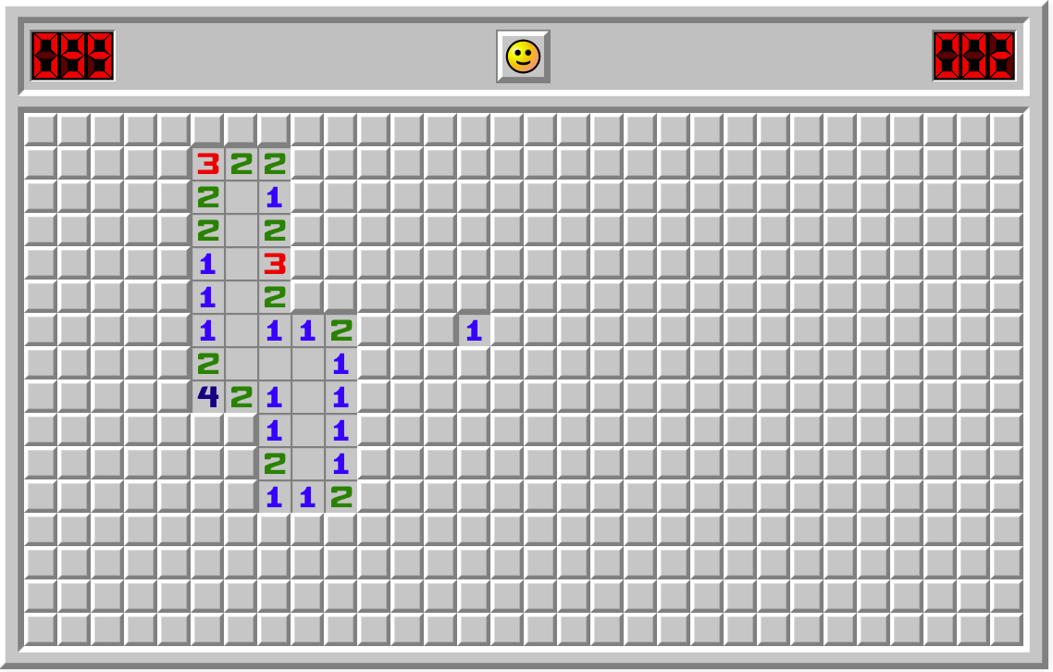
Mine sweeper
Tile based Puzzle solver game
Numbers indicate how many bombs are neighbour with the number.
Click at bomb ends with a lose
Solved in lowest time equals to highest score.

Slide 3
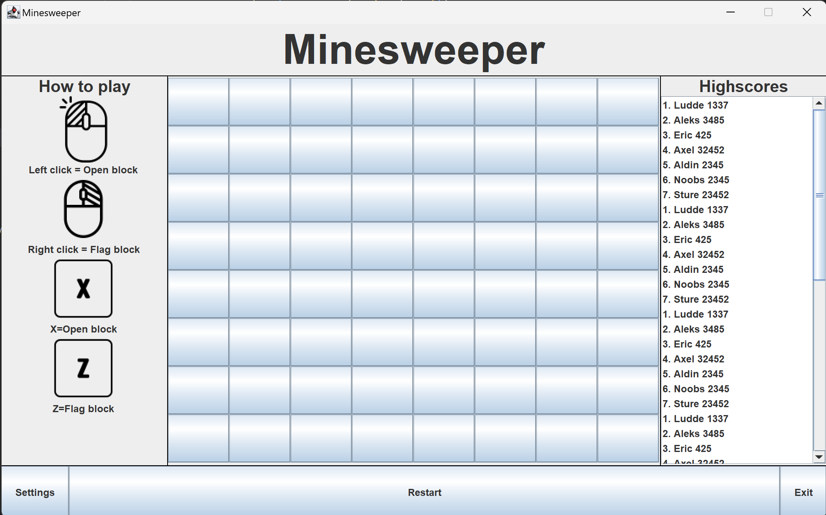
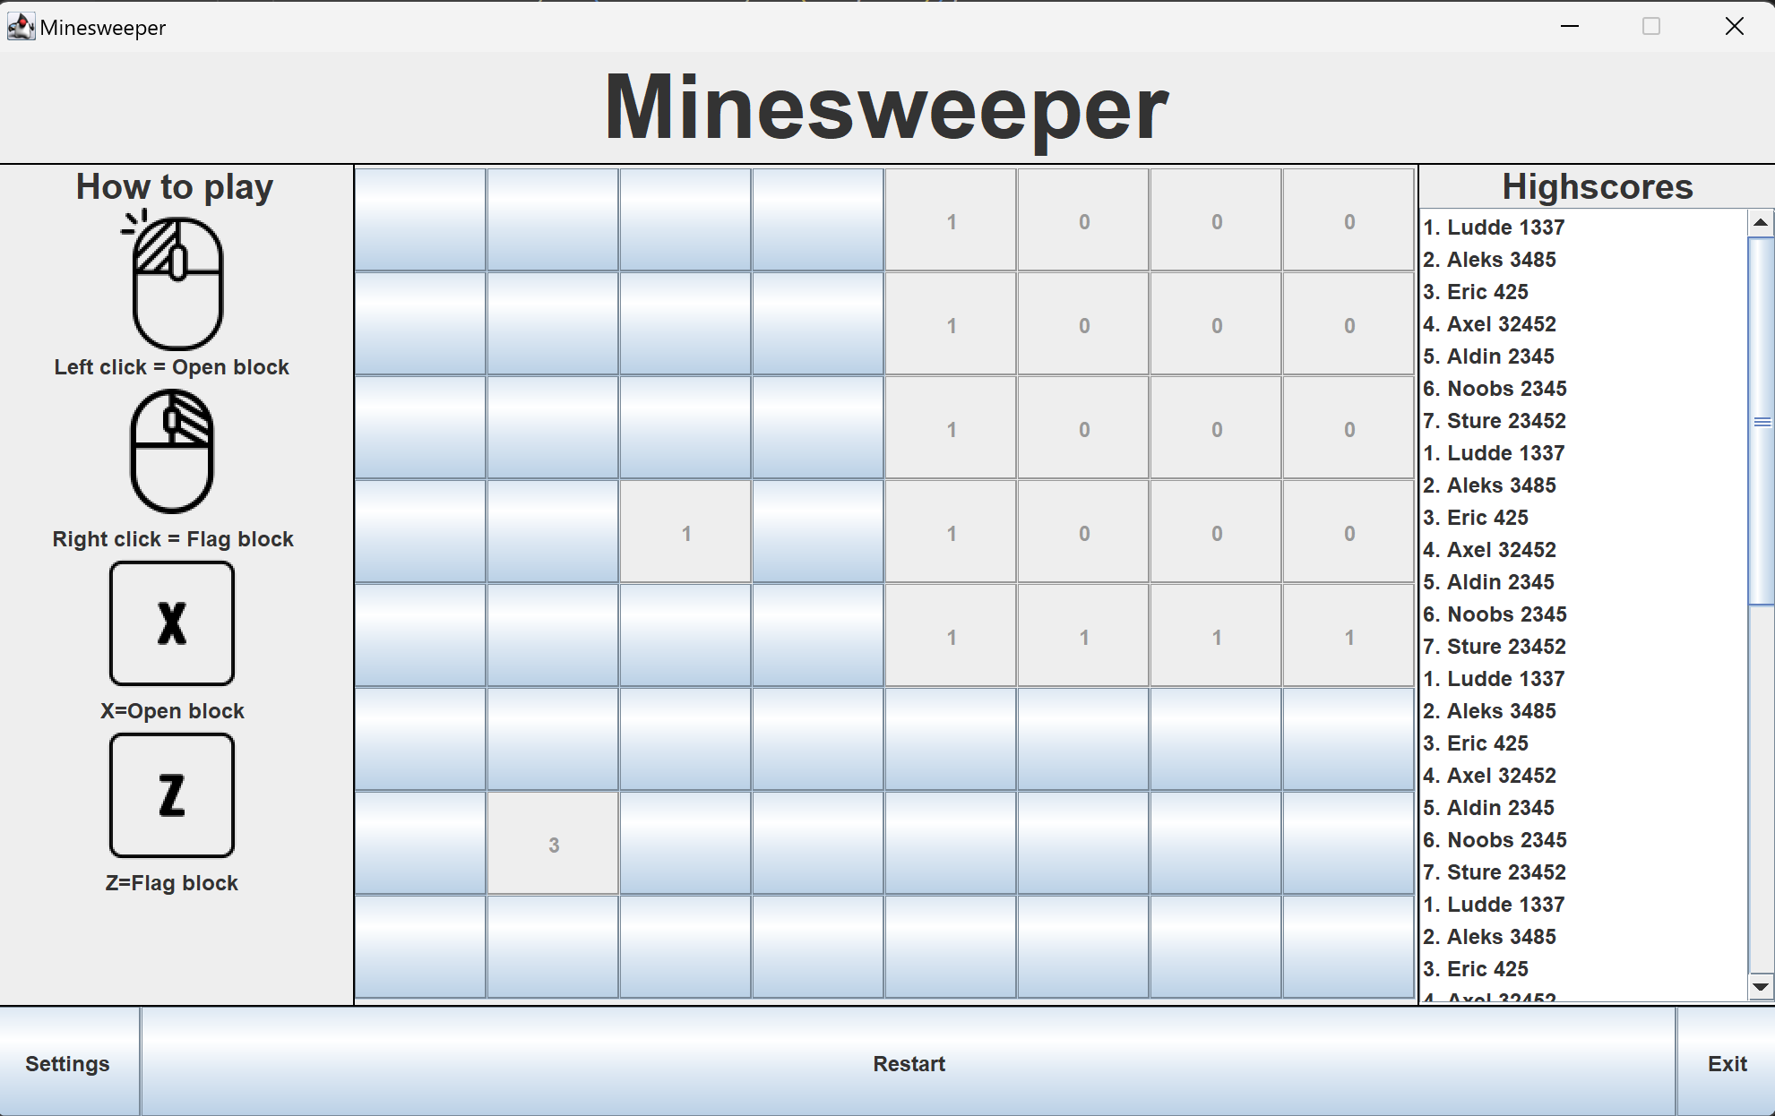
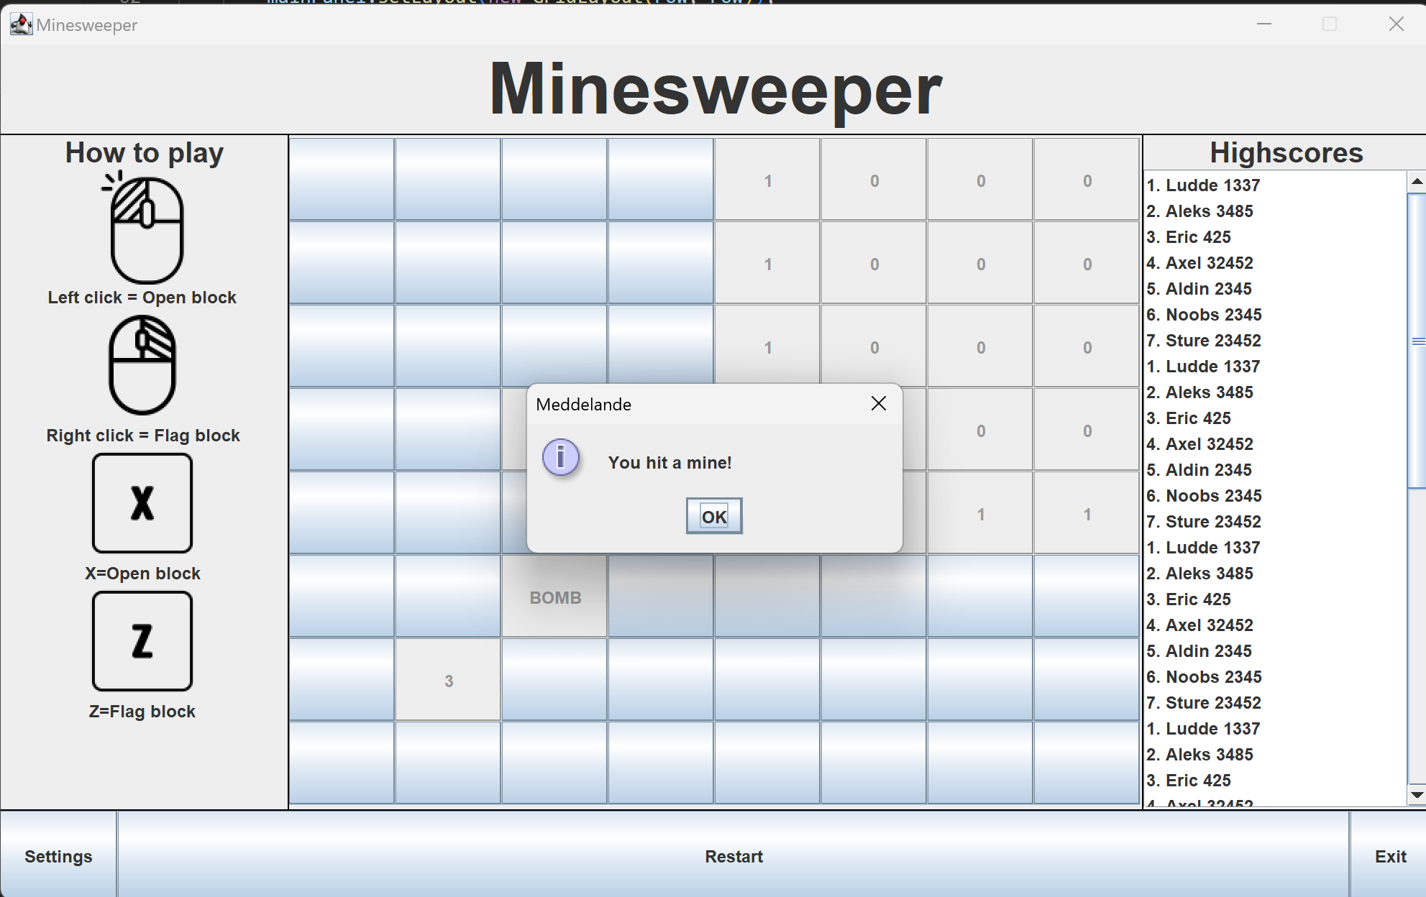
Grid & layout
Swing
Frames
Border layout
First draft

Slide 4
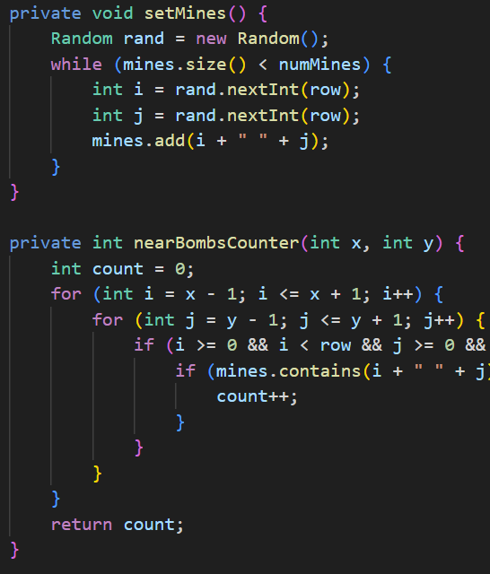
Functionalty/ mechanics
Bombs are placed
Neighbours to bombs get appointed numbers of bombs next to them.
No bombs equals to an empty cell that autoopens untill it reaches a cell with a number.

Slide 5
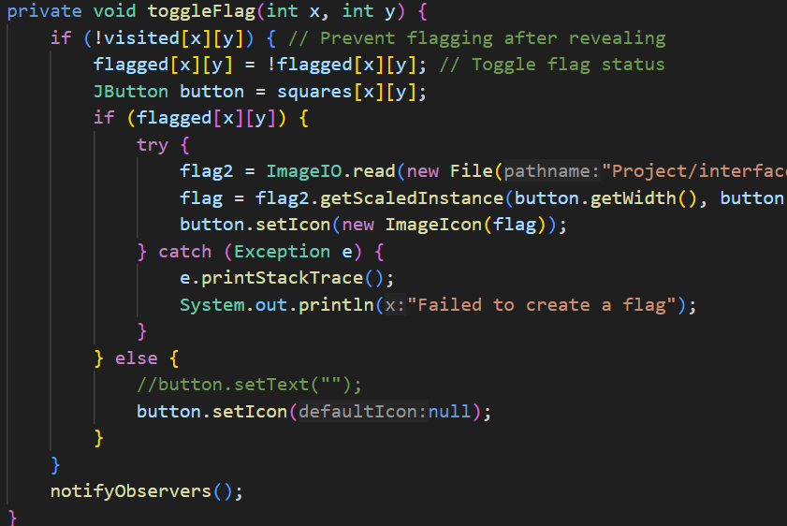
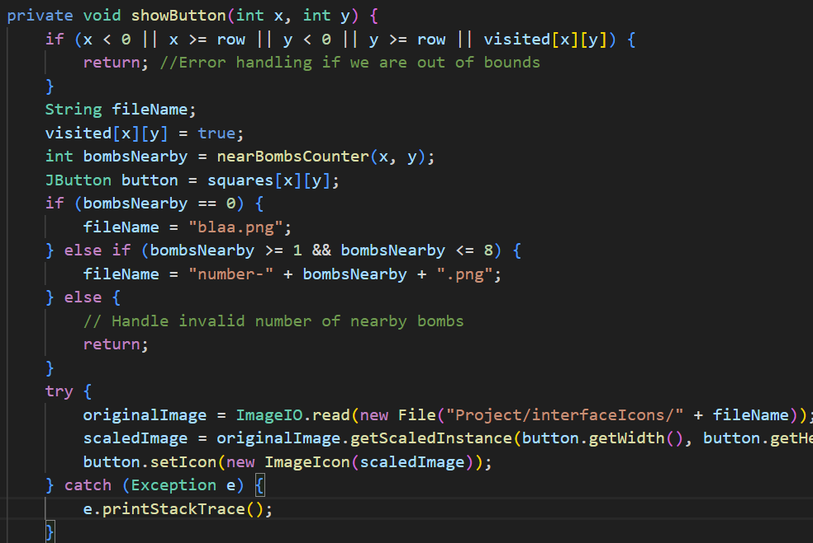
Methods

Slide 6
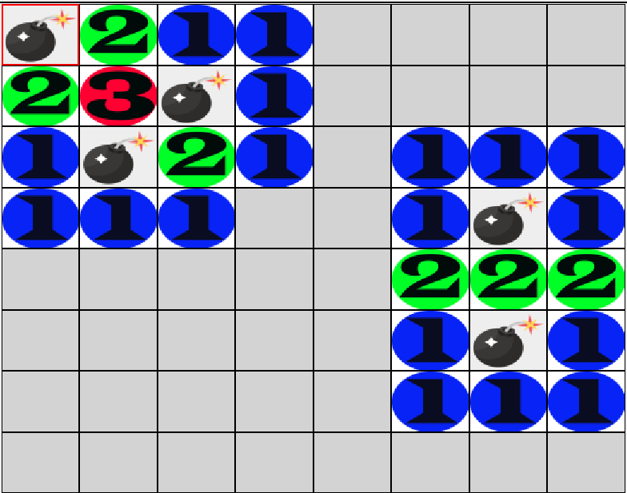
Structure / visual
A[0][0], A[0][1], A[0][2],
A[1][0], A[1][1], A[1][2],
A[2][0], A[2][1], A[2][2]
Visual improvments

Slide 7
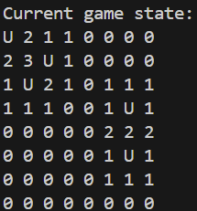
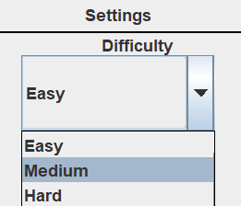
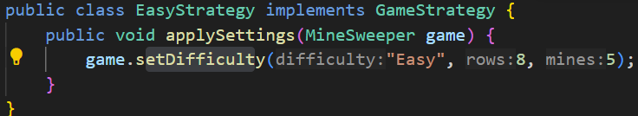
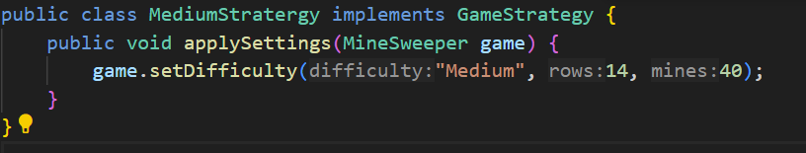
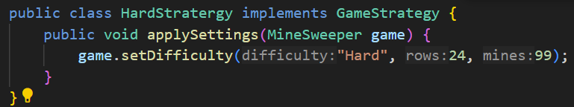
Observer / stradegy
Grafikal and terminal output
NotifyObserver();
prevGameState.java
SoundObserver.java
Settings for Stratergy lvls.

Slide 8
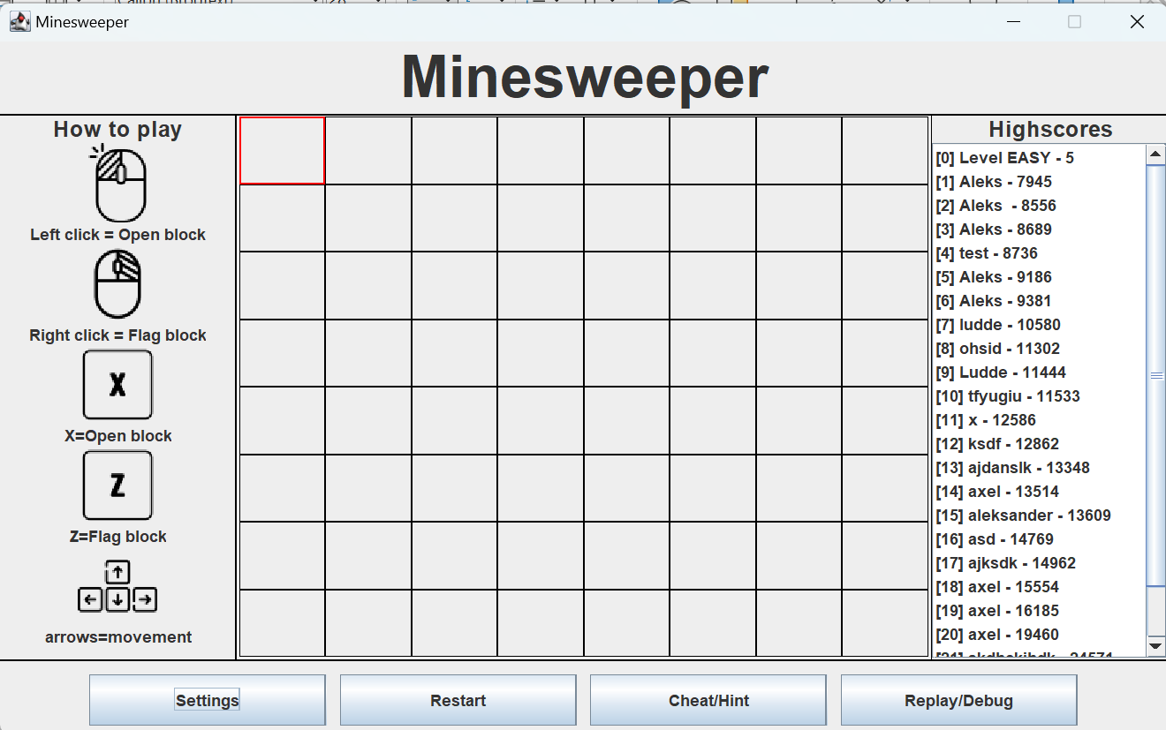
Restart / Cheat / replay-button
Restart
Cheat/hint
Replay/debug

Slide 9
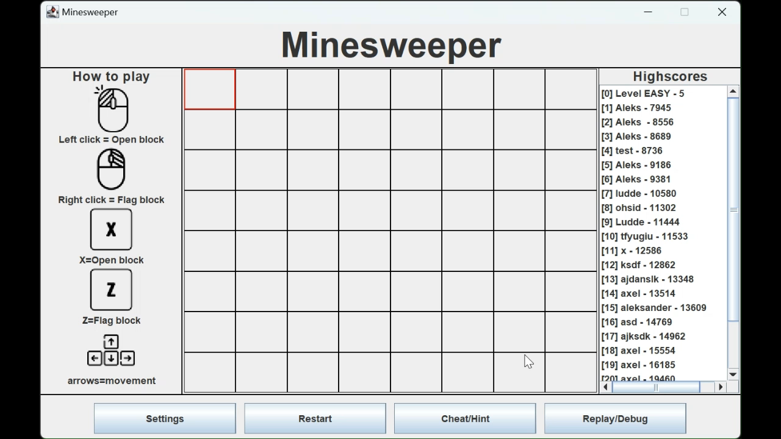
Game play
Reveal bombs
Change difficulty
Restart
Win and add highscore

Slide 10
Questions?

